Slide 1
CPMC2020
MBC Occupancy Manual
-Guide to the Building-

Slide 2
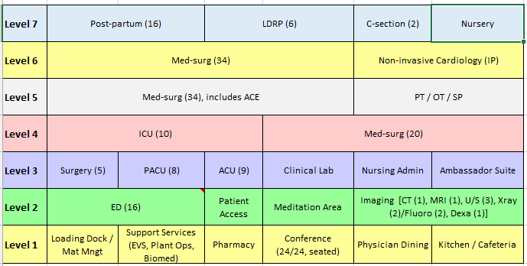
Department | Current Phone number | Extension | Department Fax Number (Telecom to Update)
Administration | 415-641-6536 |  | 415-641-7582
Emergency | 415-641-6625 | 86625 | 415-641-7598
Bed Control | 415-850-7123
S3 | 855-398-1631
Cashier | 415-641-3333 | 83333 | 641-6652
Cardiac Cath Lab | 415-600-5990 | 65990
Cardiology | 415-537-8600 | 78600 | 415-369-1370
Case Management | 415-641-6534 | 86534 | 415-821-9657
Chaplain | 415-641-6527 | 86527
Clinical Lab | 415-641-6533 | 86533
Diabetes Center | 415-600-0506 | 60506 | 415-600-6279
Dialysis (in-patient) | 415-641-3427 | 83427
Dictation | 415-641-6860 | 86860
Doctor's Dining Rm | 415-641-1204 | 81204
Doctor's Lounge | 415-641-6739 | 86739
Hospitalists | 415-912-8469 | n/a | 415-369-1240
Information /Lobby | 415-641-6510 | 86510
Lift Team | 415-600-4700 | 64700
Medical Staff Office | 415-600-6285 | 66285 | 415-750-5012
Medical Records | 415-641-6515 | 86515 | 415-641-7595
Nursing Admin | 415-641-6536 | 86536 | 415-641-7582
Nursing Stations - New
4th floor ICU | 415-641-6612 | 86612
4th floor PCU | 415-641-6610 | 86610
5th Floor Med Surg
6th floor Med Surg
7th floor FBC
3rd Floor ACU
3rd floor OR | 415-641-6635 | 86635
Pathology | n/a | n/a
Pharmacy | 415-641-6505 | 86505 | 415-641-5871
Pulmonary Lab | 415-641-6616 | 86616 | 415-641-7585
Radiology | 415-641-6545 | 86545
Breast Health | 415-641-6545 | 86545
CT | 415-641-6545 | 86545
MRI | 415-641-6545 | 86545
Ultrasound | 415-641-6545 | 86545
Registration | 415-641-6951 | 86951
Emergency Dept | 415-641-6698 | 86698 | 415-641-7597
Main Hospital | 415-641-6951 | 86951 | 415-641-7583
Monteagle - (Lab Pre-Reg) | 415-641-3351 | 83351 | 415-641-3350
Pre-Reg | 415-641-6736 | 86736 | 415-865-4176
Rehab and Therapy
Occupational Therapy | 415-641-6560 | 86560 | 415-641-3426
Physical Therapy | 415-641-6560 | 86560 | 415-641-3426
Respiratory Therapy | 415-641-6565 | 86565 | 415-641-7585
Speech Therapy | 415-641-6560 | 86560 | 415-641-3426
Security Dispatch | 415-600-0837 | 60837
Support Services | 415-600-7900 | 67900
Surgery
OR Front Desk | 415-641-6635 | 86635 | 415-641-6587
Outpatient Surgery | 415-641-6889 | 86889
PACU | 415-641-6638 | 86638
Scheduling | 415-600-6900 | 66900
Women's Center | 415-641-6996 | 86996
Main Hospital | 415-600-6000
Department Phone Directory/Floor Plan

Slide 3
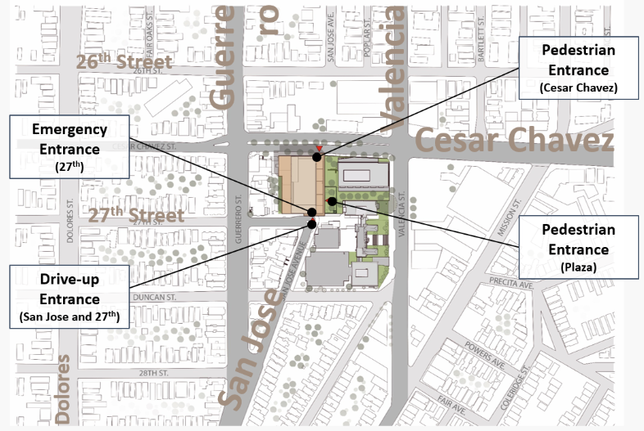
Hospital Overview
Hours of Operation
 | MBC
Hospital Entrance 1. Cesar Chavez 2. 2nd Floor Plaza | 5am – 8pm M-F *Badge reader after hours*
Emergency Entrance | 24/7
Peet’s Coffee Cart (Monteagle Building) | 7:30am-3:00pm M-F *Closed on the weekends*
Cafeteria | Weekdays 6:30a-6:30p *Closed on the weekends and after hours*
Walgreens Pharmacy (Monteagle Building) | Weekdays 9am-6pm *Closed on the weekends*
Loading Dock/Delivery Hours | Monday – Friday 7:00am to 3:00pm. Other hours by appointment only.
Shuttle Pick Up/Drop Off

Slide 4
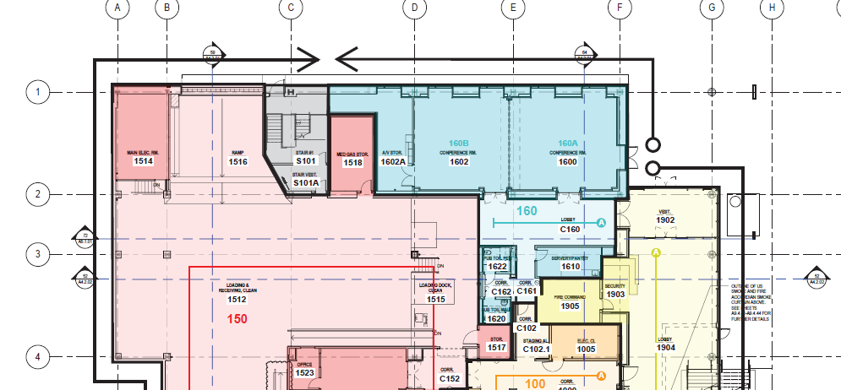
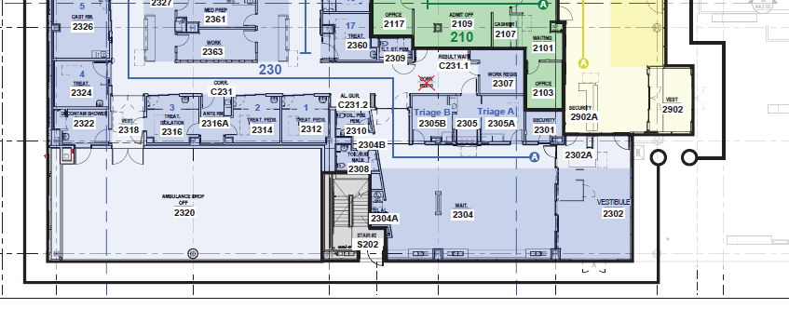
Entrances Prior to 8/25/18
All vendors and deliveries must enter through Loading Dock (GREEN STAR) during all times of staff and stock.
All other staff, contractors and personnel with access privileges must enter through Emergency Department Vestibule located the 2nd floor of 27th Street (RED STAR).
Cesar Chavez
27th Street
27th Street

Slide 5
…continued…
The Main Entrance brings patients and their families directly to the Welcome Desk in the Main Lobby where they will be greeted and provided required visitor badges to move throughout the hospital.
Patients and their families may also enter the campus through the parking garage via dedicated garage elevators.
After obtaining visitor badges, patients and families will use the conveniently located patient and visitor elevators to access the floor where the desired service is housed.

Slide 6
Loading Dock/Unloading
The Mission Bernal Campus loading dock is located on Level 1 from the Main Lobby through Corridor 1000 just past the Service Elevators, or from the exterior off the Cesar Chaves St.
Vehicle traffic will use the loading dock ramp, and foot traffic should use the door just to the East of the main loading dock vehicle entrance.
Height Restrictions: Large and small vans permitted (35 ft. truck bed restriction)
Noise Restriction: 6:00am – 8:00pm
Hours of Operation: 7:00am-8:00pm
Delivery Hours Include: Monday – Friday 7:00am to 3:00pm. Other hours by appointment only.
Traffic Flow Details:
- When “delivering clean,” trucks are instructed to pull into dirty and back into clean to minimize noise. When “picking up dirty,” trucks are instructed to pull into clean and back into dirty.
Most deliveries must come through the loading dock. This includes postal mail, FedEx, etc. exception includes florist, patient gifts, etc.
Dock entrance is not to be used by employees unless operating one of the authorized hospital vehicles. Not an employee entrance.
3 spaces within the loading dock will be designated as “drop-off only”. Parking is not allowed. Violators will be ticketed or subject to tow.

Slide 7
Loading Dock/Unloading …continued…
There are two areas of the loading dock, a clean area and a soiled area.
All clean supplies, food and linen will enter through the clean area.
All soiled linen, waste, used/ soiled rental equipment, and the trash compactor will be managed through the soiled loading dock area.
Dock entrance is not to be used as a general employee entrance and is not to be used by employees unless operating one of the authorized hospital vehicles.
Dock locations are for the loading and unloading process and are not to be used for parking. Drivers of all vehicles must shut off the engines within the dock areas.

Slide 8
Deliveries
Business Hours
Florist, Patient Gifts, etc.: Deliver during business hours only (after grand opening), will come through Cesar Chavez entrance and deliver to front desk lobby for volunteers to bring up.
Must park in short term parking spaces in garage, do not use patient drop off zones.
Delivery After Hours:
All vendors must enter through 27th street Emergency Department vestibule entrance and check in with security.
Emergent/Urgent deliveries only!
Material management team will train vendors to paths of travel.
Note: No personal packages should be sent to your work location. Only hospital related packages, personal packages will not be signed for by receiving staff.

Slide 9
Badge Access & Entry Overview
Universal/Base Access
Restricted Areas
All exterior doors with card readers
All back of house space (hallways, etc.)
Multidisciplinary/Conference Rooms
Consult Rooms
Bicycle Storage
Locker Rooms
Emergency Department
Imaging Entrance
M/S, L&D and M/S Patient Floors (unless otherwise specified)
Medrooms
Clean/Soil Utility Room
Medical Equipment Rooms
Nourishment Rooms
Food & Nutrition Area
Biomedical Engineering
Pharmacy
Materials Mgmt/Supply Chain
Security
Admitting
Clinical Lab
SPD, OR, PACU/ACU
Nursery/SCN
PT/OT Area
Administrative Suite
PBX
Morgue

Slide 10
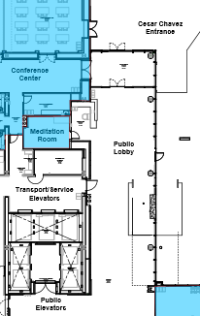
Elevator Usage
Transport/Service Elevators
Total: 3
Users: Employees, Physicians, Patient Transport
Patient being transported will be prioritized and elevators should be made available.
Badge access required!
Public Elevators
Total: 4
Users: Patients and Visitors
Badge access not required

Slide 11
Badge 101
Employees, Volunteers and Physicians
Badge must be worn at all times, many doors will require badge reader to upon entry.
Staff must tap their badge to the respective device, in order to activate the corresponding system
Registry staff will be required to show registry ID before being issued a badge. These need to be return to charge nurse end of shift.
Internal stairwells can be used for exiting the building, however re-entry will be on the ground floor.
Please pay attention to your surroundings and ensure that no one enters behind you when badging in.
If you forgot your badge, please go to the Security Desk for a temporary badge.
Visitors
Visitor badges are required and can be obtained on Level 1 or Level 2 Security Desk.
Photo identification will be required for those 18 years and older.
Children who are coming with their parents can have their photos taken at the security desk for badge issue.
Badges will become VOID after 6-8 hours and will need to be re-issued.

Slide 12
Lost & Found
Located in the 1912 building on the 4th floor. Please contact security if you have a missing item that cannot be located.

Slide 13
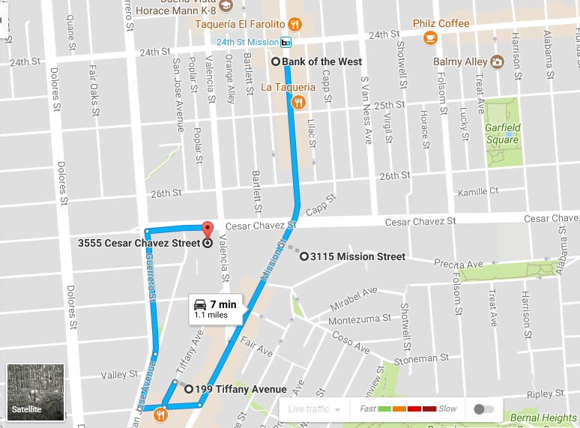
Shuttle Schedule & Routes
NEW MBC24 Shuttle Route!
Shuttle will run between MBC and 24th Mission Bart every 30 minutes all day (0600-1800).
Schedule can be found here.
MBC24 shuttle is available NOW (as of September 2017) for a limited hours (2pm-6pm) until MBC opens its doors.
NEW Offsite Staff Lots
NEW Offsite Staff Lots

Slide 14
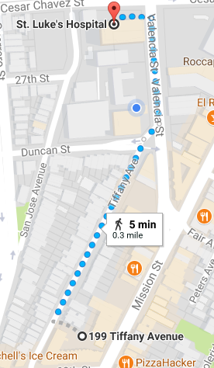
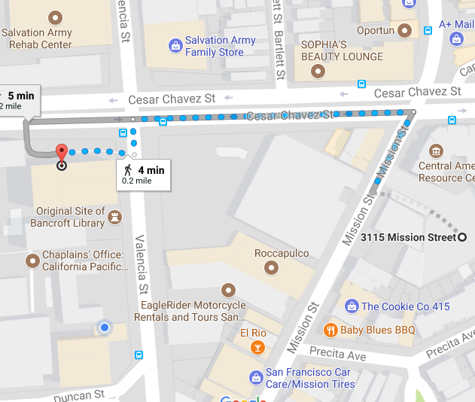
Additional MBC Offsite Parking
2 additional parking lots have been made available to provide an additional 40 parking spaces for our employees during business hours.
Cesar Chavez St. Garage will still be made available to all employees after hours and on weekends.
3115 Mission Street Parking Lot
199 Tiffany Avenue Parking Lot
Additional parking lots are approx. 5-minutes away walking from the new hospitals.
Security escorts are available if needed.
NEW Offsite Staff Lot
NEW Offsite Staff Lot

Slide 15
Parking (…continued…)
Visitor Parking
Parking is available for all patients and families, accessible off of San Jose Ave.
Payment machines are available on each level in the elevator lobby. Payment may be made in the form of cash and credit. Cashiers are not stationed at the exit gates.
Level P1 has van accessible spaces and spaces for oversized vehicles.
The parking garage elevators go directly to the Main Lobby where all visitors are to be badged at the Welcome Desk.

Slide 16
Public Transportation
Shuttle services are available for employees, patients and their families from 24th Mission Bart.
Patients and family members may obtain further information on available public transportation and shuttle timetables at the Welcome Desk.
Staff and providers may visit our Intranet for more information related to public transportation and shuttle timetables.

Slide 17
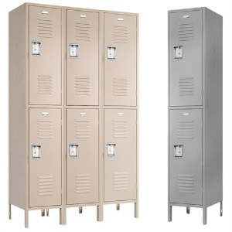
Staff Locker Usage
All lockers will be day use only.
Department manager is responsible for handling locker buddy assignments and distribution.
Lockers accept padlocks and are two or three high.
Department Lockers | Location
Pharmacy | Level 1
Kitchen | Level 1
Materials Mgmt, EVS, Biomed, Engineering | Level 1
Emergency Department | Level 2
Imaging | Level 2
Surgery, Prep/Recovery, PACU, CSPD | Level 3
Lab | Level 3
ICU | Level 4
Medsurg, IP Cardio Diagnostics | Level 4 & 5 & 6
Respiratory Therapy | Level 4
LDR | Level 7

Slide 18
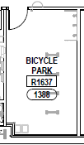
Bicycles & Locker Space
All bicycles can be stored on the 1st floor (badge reader access) Room 1388 – First Come First Serve
Storage room is accessible via 1st floor 27th St. or Cesar Chavez front entrance (through conference center corridor)
Employees are encouraged to submit registration form in advanced (to parking office) to secure space and program badge.
No locker available– employees will required to store personal belongings in lockers on their floors
All staff can use 1st floor showers, however items cannot remain stored for day use.

Slide 19
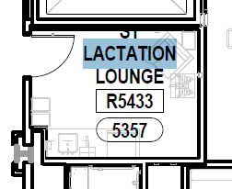
Lactation Lounges
Lactation lounge available for physicians and staff only. Not for patient use. Rooms are located on the 5th floor (Rm. 5357) and 7th floor (Rm. 7623) of the hospital.

Slide 20
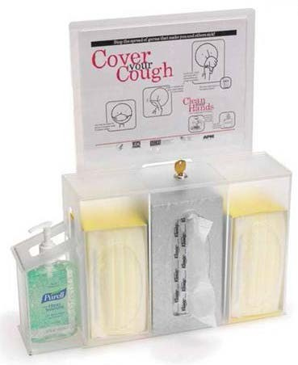
Respiratory Etiquette Stations
To prevent the transmission of respiratory infections, complimentary respiratory etiquette stations with gloves, gel, and masks are available near the waiting rooms and throughout hospital corridors.

Slide 21
Waiting Areas
Public waiting areas and lounges are available on the 2nd and 3rd floor of the hospital.
For safety reasons, patients and families should be encouraged to refrain from rearranging furniture in the waiting areas. This will help prevent accidental blocking of the retractable fire doors.

Slide 22
Dining Services
Public vending machines are located on the 2nd floor near the public elevators and lobby.
Grab and Go as well as our Cafeteria is located on the first floor. Hours of operation are from 6:30a-6:30p Monday-Friday. Closed on the weekends and after hours.

Slide 23
Conference Rooms
Conference Rooms are available on the patient care floors for patient care team use.
There are conference rooms on the 1st and 2nd floors, available for hospital and public use.
Reservations are available online through Event Management System (EMS)
Each room is equipped with large monitors and projectors
Rooms will be locked after hours, by Security, and re-opened by Security
There will be video displays outside of these rooms that will provide meeting schedule
4 Conference Rooms
Room 1600
Room 1602
Room 1600+1602
Room 2910
Oversight and scheduling of these rooms lie with the Nurse Manager.
In general, these can be used for small classes, inservices, department meetings

Slide 24
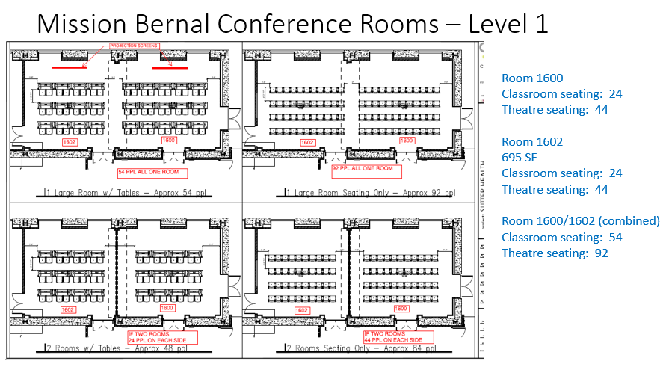
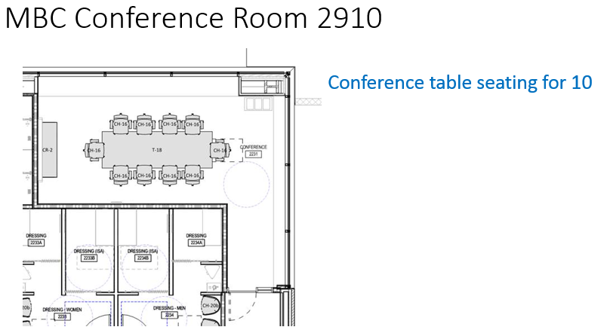
Conference Rooms …continued…

Slide 25
Room Reservations/Catering Requests
Catering Requests
Reserving Rooms
All catering requests must be submitted to the Food & Nutrition Department three business days in advance of the meeting or event. Approval by department director is required for any catering event that meets the catering guidelines.
A meeting is defined as:
Occur before 8:00am or between the hours of 11:00am-1:00pm; AND
Have a minimum of 10 people in attendance; AND
Are 4 hours or longer in length, OR
Physician attended
A separate request must be submitted for each event (i.e. one for breakfast, one for lunch)
Forms must be submitted with the appropriate signature.
Approval must be obtained by receiving a live signature on catering order.
Typed signatures or approval via email will not be considered appropriate approval.
Recurring events may be submitted on the same form if menus are identical and dates are clearly listed.
Complete Online Conference Room Request form
Link: http://dcpwdbs405/virtualems/

Slide 26
Shared Spaces
Multi-disciplinary Workroom
Conference-style type room, located on the VNC patient care floors that can be used for small group meetings, education sessions.
Typically accommodates ~10 people sitting around a rectangular conference table
AV capability – large wall monitor with projector capability
Inter-disciplinary Workroom
Individual computer workstations in a shared workroom environment. Workstations are to be used for patient care providers, while providing patient care on the respective patient care floor. Workstations are not to be “claimed” for any specific individual use.
Shared workspace environment etiquette is enforced
Quiet workspace
no eating
clean up after yourself
Consult Rooms
Room that patient care providers can use for private conversations with patient family member(s) and/or significant other.
Room is to be cleaned up after use.
Lock – key with nurse manager
Family Rooms
Public area for family members to sit and gather, outside the patient room

Slide 27
Shared Spaces …continued…
On-Call Rooms
There are 2 non-dedicated on-call rooms: 5361, 5359
Contact Support Services to reserve an on-call room (up to 1 week in advance). This can be done via …
Call x77900 (415.600.7900)
Log-on to Online room scheduling portal and reserve
Requestor will receive an email confirmation
After hours requests can be directed to either PBX (Telephone Operator) or Nursing Supervisor for “same day” request
Staff Lounges
For use by non-physician staff who work on the respective patient care floor
Nursing staff are responsible for cleaning the coffee maker

Slide 28
Interpreter Services
Our Interpreter Services Program offers the following services:
In person interpreting by professional trained medical interpreters
Video and/or telephonic interpreting via dual handset phone system
These services are available to all departments at no cost.
Please access Interpreter Services by calling x61077, Pin#1025.
Notes:
61077
pin 1025

Slide 29
Water Cooler/Bottle Filling Stations
Drinking Water Options:
Plumbed coffee makers with hot water dispenser for immediate hot water available on certain floors
Water Coolers Locations:1) PBX (1st floor) and 2) Inpatient Rehab Gym. There are no provisions for bottle water coolers at VNG.
Ice makers are available in patient nourishment rooms, not in staff lounges.
Drinking Fountain/Fill Locations: Emergency Department, Cafeteria and Surgical Waiting Room
Emergency Water:
VNG will have fully functioning potable water tank at Move-In – do not need to move emergency water stores from Cal or Pac.
MBC will not have fully functioning potable water tank at Move-In – STL will need to move their emergency water stores and keep until the tank is operational.

Slide 30
Supply Chain & Medical Gas Area
The Supply Chain team is responsible for the replenishment of Medical Gases which will be housed centrally in the Medical Gas storage room on Level 1, accessed directly off the loading dock in room 1518.
The supply chain area is also located on Level 1 adjacent to the loading dock. Staff, supplies, and receiving will be staged here to support a Low Unit of Measure (LUM) Just in Time (JIT) distribution model. The floor plan room number for this area is 1522.
The Code Blue Cart quick reference guide can be found here: http://mysutter/bay/CPMC/About/News/Department%20Newsletters/CrashCarts.pdf
Broselow quick reference guide can be found here: http://mysutter/bay/CPMC/Clinical/Nursing/Need%20to%20Know/BroselowCrashCart.pdf

Slide 31
Supply Chain Stat Requests
Normal Business Hours Central Distribution: x86626
Normal Business Hours Receiving: x86901
Supply Chain Staff will be onsite between the hours of 7AM- 4:30PM M-F.
Par Levels for supplies on the units will be calculated for 4 days of inventory on hand.
For supply needs during evening and weekends when Supply Chain staff are not onsite, unit staff can contact the Nursing Supervisor who will have access to the Distribution storage area as per current process.
Supply Chain Staff will manage the restocking and storage of Code Blue/ Broselow resuscitation carts.
Supply Chain Intranet requests: http://apps.insidecpmc.org/CPMC_SRQ/servlet/LoginServlet?cpmc_role_id=180

Slide 32
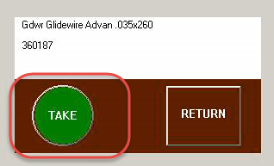
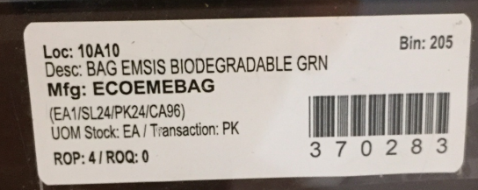
Pyxis
The Pyxis Supply management system will be used in a combination of locked and unlocked cabinets.
Locked Cabinets will be utilized for securing IV solutions, intravenous or interventional supplies, and patient chargeable supplies.
Note that due to space constraints, some supplies that do not meet the criteria of heightened security may also be stored in these locked areas.
Items that are Patient chargeable will have a Pyxis button label used for billing the supply to the patient record. That button looks like this:
Items that are not patient chargeable will have a label that looks like this:
Pyxis Supply Dispensing and revenue capture will represent nearly $400,000 in annual supply revenue at Mission Bernal Campus. Correct use of these devices is critical to maximizing the benefit of these systems. On the following page is a brief instructions for use:

Slide 33
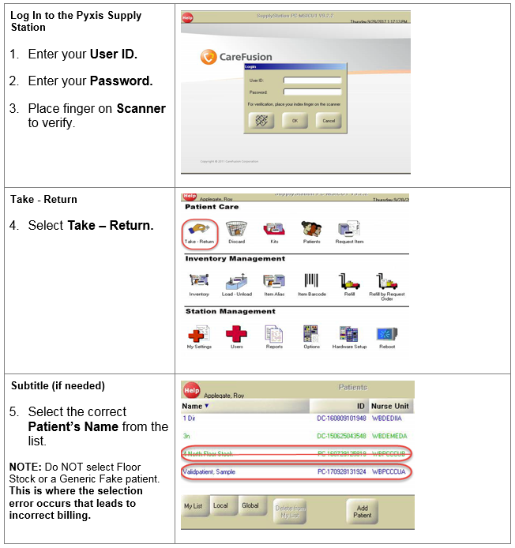
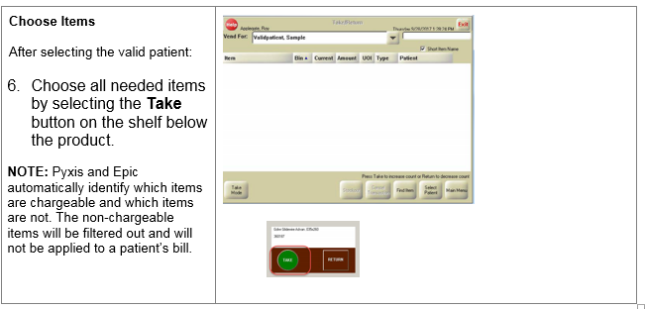
Pyxis …continued…

Slide 34
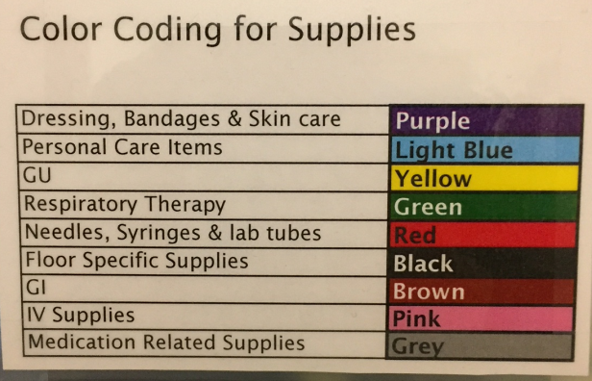
Pyxis …continued…
Pyxis supply stations as well as wire shelving units will utilize a standard color coding and layout to make locating supplies more intuitive.
Here is a sample of how this color coding will look:
Dressings Bandages and skin Care: Purple
Lower center
Personal Care Items: light Blue
Not specified
Urology: Yellow
Lower Left
Respiratory Therapy: Green
Upper Left
Needles, Syringes and Lab Tubes: Red
Far right central
Floor specific supplies: Black or no color
Not specified
GI supplies/ feeding tubes: Brown
Central Top
IV Supplies: Pink
Left side central
Medication related supplies: Grey
Not specified
Supply Chain staff will Monitor supply levels and the automated supply system will generate refill requisitions to order inventory.
Supply Chain will receive delivery from our primary distributor at 8PM Monday through Friday.
Supply Chain will remove corrugated cardboard at the loading dock as per infection control policies, and deliver supplies to the Pyxis and supply cart areas throughout the hospital.
Nurse Server carts are department specific and are non-standard storage options some departments use. Supply Chain does not manage or replenish supplies on these carts.

Slide 35
Equipment Cleaning
Movable Medical equipment such as IV pumps, SCD pumps, etc. will be tracked, cleaned and transported by Equip/ Bio-Med staff. In some cases specialty equipment solely used by a specific area will be kept and maintained by that area owner.

Slide 36
Aeroscout
AeroScout is the chosen RFID (Radio Frequency Identification) equipment location system as well as temperature monitoring.
When a device’s temperature goes out of range, department will receive an alert through MobileView, if during department hours of operation. Plant Operations will receive secondary alerts, as well as primary alerts when departments are closed
Essentially equipment that moves will be targeted for RFID tracking.
Items that will have RFID tracking includes but is not limited to:
Beds
Patients, infants or child (HUGS System)
Wheelchairs
Gurneys
IV pump brains & modules
PCA pumps
Other infusion pumps (mobile)
SCD
Defibrillators
Vital sign monitors
Portable imaging machines
EKG machines
Bladder Scanners
Etc.
Staff will be able to log into the system and search for items using various keywords:
Description (users)
Asset Tags (Bio-Med)
Department
Training on the system will be provided through specific AeroScout training prior to move in.

Slide 37
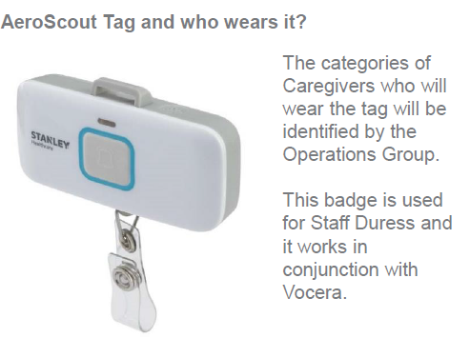
Aeroscout …continued…
Through our Aeroscout staff duress system, staff will be able to silently notify Security that they require assistance by pressing the button on their Aeroscout tag. Security will be able to locate the staff in need, via the RFID tag.

Slide 38
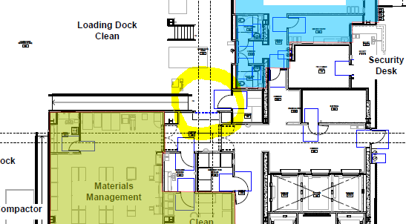
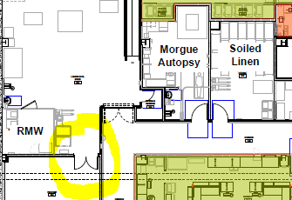
Linen
Linen will be managed and delivered by EVS at Mission Bernal Campus just as it has been managed at St. Luke’s.
Clean linen will be stored in room 1404, next to the Materials Management area adjacent to the loading dock.
Soiled linen will be stored in room 1308 and will exit the building through the designated “Soiled” exit pathway as shown in the diagram below.
Clean linen will enter through the “Clean” entrance as shown in the diagram below.

Slide 39
Durable Medical Equipment (DME) Storage
The DME process will be the same as currently in place with consigned inventory available in certain closets near patient care areas in the ED, OR/PACU and Inpatient Units.
These pieces of equipment will be replenished by our DME partner Pacific Medical.

Slide 40
Additional Technology Includes:
Vocera
Vocera is a communication system which …WE KNOW THIS IS STILL TBD Note that NOT listed in Table of Contents
Patient lift system and mobile lifts
We have overhead patient lift systems in all of our med/surg and ICU patient rooms, to assist with patient mobility in bed and around the room.
This is one of our safety features – to assist with patient mobility and reduce the risk of associated employee injuries
In addition, we will have mobile lifts available for use in patient care areas, to assist with patient mobility, where ceiling lifts are not available.
Pneumatic Tube System
Our pneumatic tube system will assist with transporting medications, lab specimens and blood products to/from patient care areas, to expedite patient care.
Our system will have an enhanced “secure send” functionality which will only allow appropriately licensed staff to send and receive medication and blood products.

Slide 41
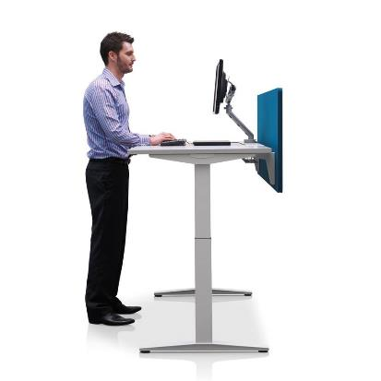
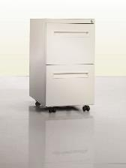
Office spaces
Administrative spaces have
Electric sit/stand desks
Monitor arms
Ergonomic task chairs
Electrical outlets on the desktop for device charging
Mobile personal storage - keys will be provided for assigned locations
Task lighting

Slide 42
HIPAA - Confidential Document Containers
Confidential document containers are located throughout the hospital. These are emptied every two weeks by the shredding company.
If one needs emptying prior to a regularly scheduled pick up, call the Support Center (x67900) to arrange for EVS to empty it.
Mission Bernal is dedicated to being a green facility, however, so please remember to THINK BEFORE YOU INK.

Slide 43
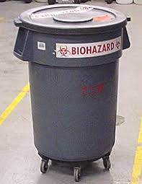
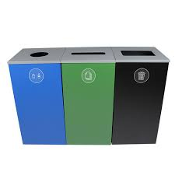
Sustainable Waste Removal
Mission Bernal is designed to be a green hospital. This includes recycling, composting, red-bag (biohazard), pharmaceutical and toxic waste management and medical equipment reuse.
Waste will be separated into streams allowing patients, visitors and staff to contribute to our creating a healthy planet
In office spaces and public areas, receptacles are provided for co-mingled recycling (blue) and regular trash (black).
In the staff lounges and conference rooms there are receptacle for three waste streams co-mingled recycling(blue), regular trash (black), and composting (green).

Slide 44
Faxes
There will be a very limited number of traditional fax machines used only in areas where electronic faxing is not possible.
Most faxing will be done using RightFax
Faxes will be received into an electronic inbox
Faxes can be read on-line and optionally saved or printed
Outbound faxing will be done by scanning and sending using the RightFax application
The Electronic Health Record (Sutter eHR) will fax records automatically as required by clinical workflows.

Slide 45
Multi-Function Printers (Scan, Print, Copy)
Multi-function networked printers are located throughout the facility and can function as copiers, scanners and printers.
Print jobs can be retrieved by tapping your badge on the sensor located on the printer of your choice.
Some workflows will default to specific printers (e.g., in the ED)
Copier and printer support is provided by the Sutter Health Service Desk which is accessed by calling 888-888-6044 or accessing the IS Portal at IS.SUTTERHEALTH.ORG.

Slide 46
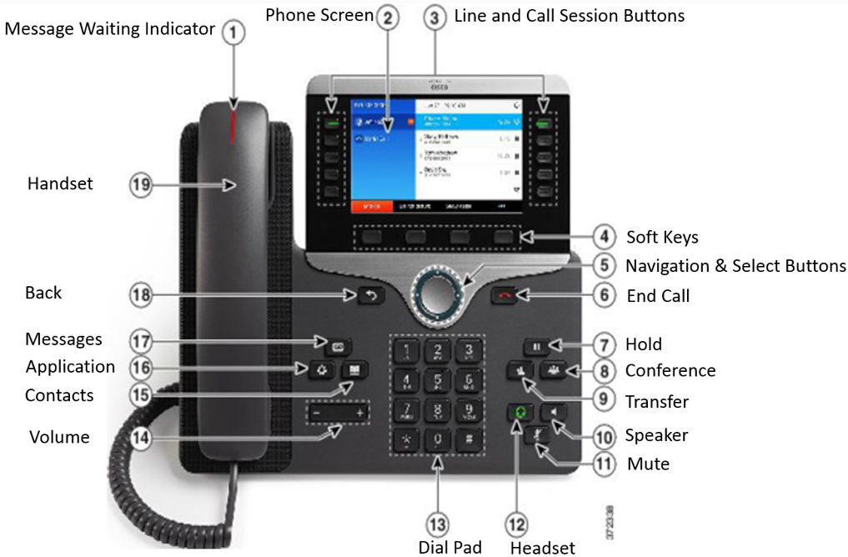
Telephone System
Cisco Voice over IP (VoIP) infrastructure desk, wall and wireless phones.
Cisco Unity Voice mail
All traditional phone features such as on hold, speaker phone, call forwarding, and conferencing
Connects to the Vocera application so that calls can be make between telephones and Vocera badges.
Informacast for paging and broadcast messaging
Emergency red phones will be installed in key locations

Slide 47
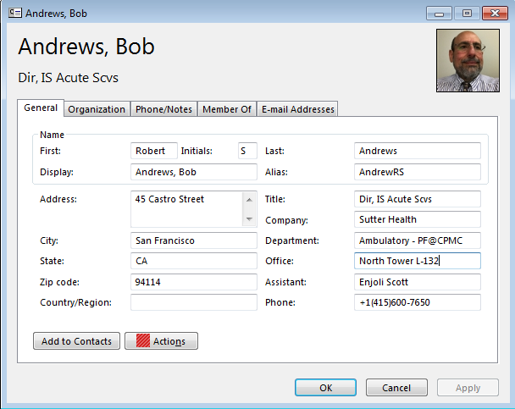
Department Phone Directories
We will be using the Microsoft Outlook Address Book as the department phone directory for all CPMC Campuses.
The normal processes for adding / changing staff locations will synchronize with the address book to keep the directory accurate without additional administrative work.
Advanced searching on any of the address book fields is possible for quick lookups.

Slide 48
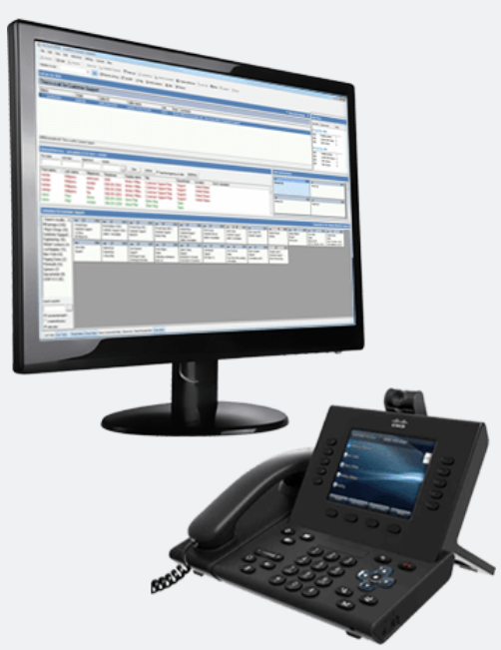
PBX System
PBX Operators will be located at both the Van Ness and Mission Bernal Campuses.
Vista Point Enterprise Operator Services System will support the PBX operator workflows and assist in the management of call queues, routing and call handling statistics.
PBX operators will have Nurse Call and other alarm panels at their stations to assist in routing of alerts.

Slide 49
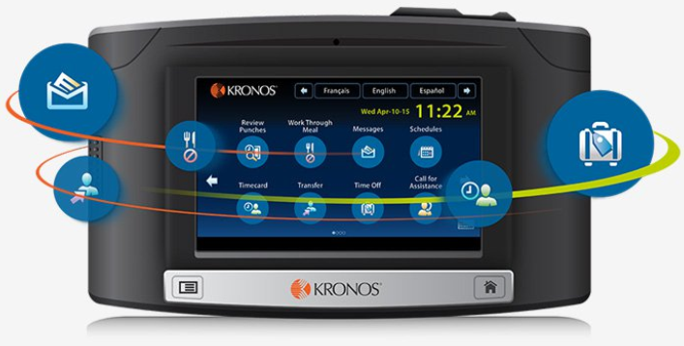
Kronos Time Clocks
New InTouch Wall Clocks
Conveniently Positioned
Elevator Lobbies
Main Corridors
Lab & Pharmacy
Some Staff Lounges
Web Application will also be available for some users

Slide 50
Patient Entertainment / Education (Sonifi)
Full complement of TV Programming
View Assigned Educational Content
Complete questionnaires
Order patient meals
View care team information
Access patient schedule
Interact with their care team
Controls and Volume Integrated Into Pillow Speaker

Slide 51
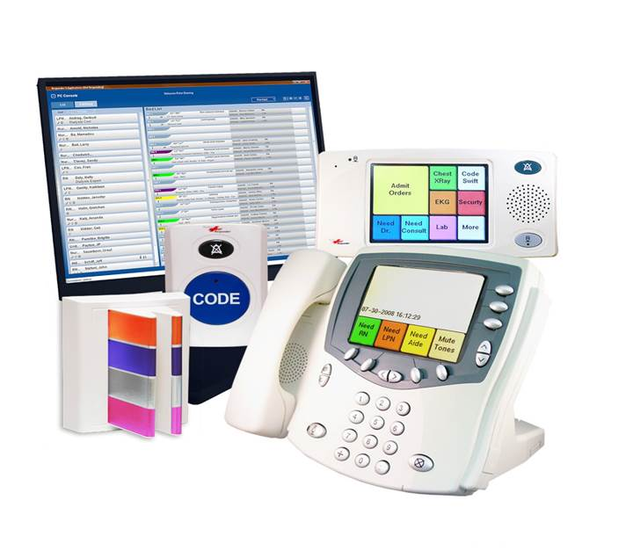
Nurse Call System
The Nurse Call Rauland Responder 5 system is an application which enables the patient to alert staff from the bedside, among other patient locations. The system utilizes devices at the bedside and in the patient room to accomplish these important notifications. The Nurse Call Rauland Responder 5 system has THREE primary functions:
It serves as a code required system for patient safety & security.
It provides a patient alert-communication system (for hospital staff) which assists patients and allows for increasingly efficient hospital operations.
It interacts with other systems to provide access to patient entertainment and education.
Additionally, the system generates a number of reports to be used in various ways throughout the departments.
Identified alerts will integrate with other applications in order to produce hospital-wide communications and notification acknowledgement which will contribute to synergized patient-to-staff experience.

Slide 52
Digital Signage
All nurse stations will have digital display boards to display patient census
Specialized display boards will also be present in the ORs and Emergency Department
Conference rooms will have digital signs indicating the daily schedule
A digital donor wall will be present in the lobby areas
Electronic informational kiosks will be located at main patient entrances to facilitate wayfinding
The cafeteria will have digital signs displaying the daily menu

Slide 53
Fire Response = RACE
Fire Safety Plan
Smoking is prohibited in all buildings and vehicles at all times
Check cords and equipment
Report problem
Know where pull stations and fire extinguishers are located
Know evacuation routes – stop and look – where are the exit signs
Rescue - Rescue/Remove person(s) from the immediate danger
Alarm - Active the nearest fire alarm pull station then call 44444 and/or 911
Confine - Confine fire and smoke by closing all doors in the area.
Extinguish or Evacuate - Extinguish a small fire by using a portable fire extinguisher or use to escape from a large fire. Evacuate the building ONLY upon order of the Incident Commander or the Fire Dept.

Slide 54
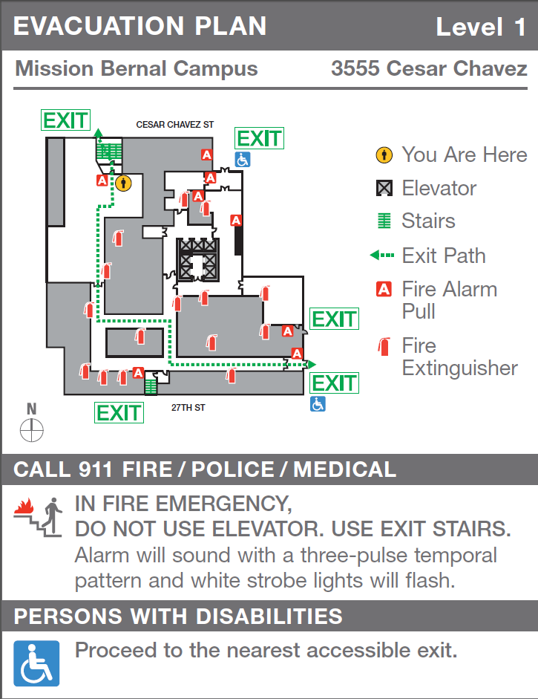
Evacuation Routes
Evacuation routes can be found on each floor displayed on signs similar to what you see on the right.
In the case of an emergency, please remember to dial 9-1-1

Slide 55
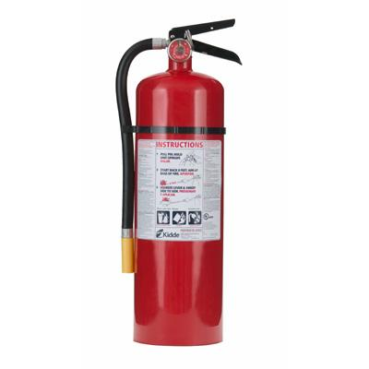
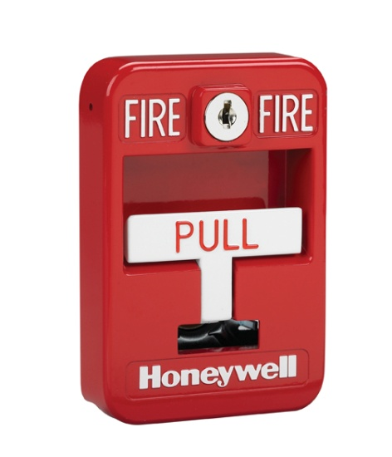
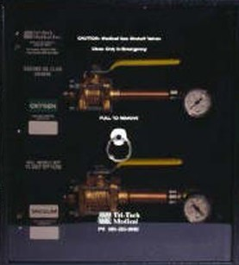
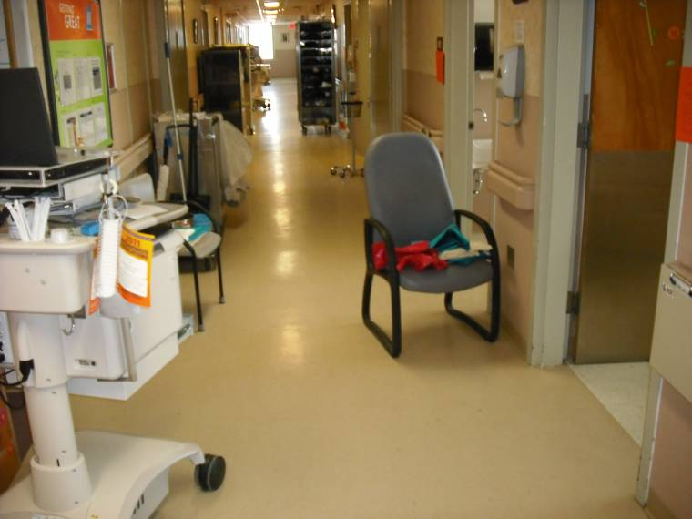
Never store anything or block access to:
Pull Stations
Med Gas Valve Boxes
Fire Extinguishers
Path of Egress
(Except for Crash Carts, Isolation Carts, or “In Use Equipment”)
Including wheelchairs & carts!

Slide 56


How to Use a Fire Extinguisher - PASS
How to Use a Fire Extinguisher:
Pull: Pull the safety pin on the extinguisher.
Aim: Aim the hose at the base of the fire.
Squeeze: Squeeze the handle
Sweep: Sweep the hose across the base of the fire from side
to side.
* Only use an extinguisher if you are trained

Slide 57
What to do if you get injured while working:
Notify your site supervisor immediately
Seek medical treatment if needed
Complete an electronic report of injury (MIDAS)

Slide 58
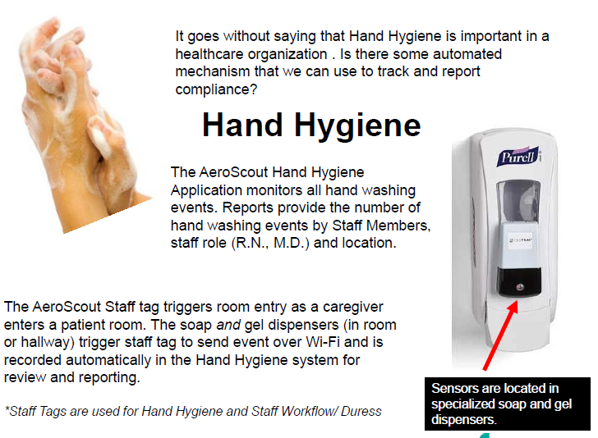
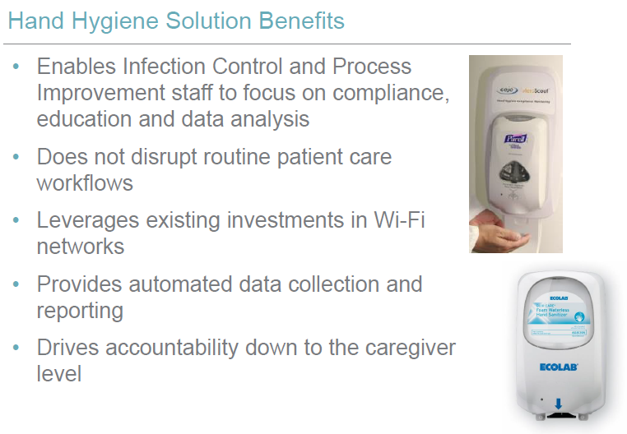
Hand Hygiene
Through our Aeroscout Hand hygiene system, we will be able to monitor our hand hygiene compliance in patient care areas

Slide 59
General Rules
Hard hats and closed toe shoes will not be required during staff & stock
ALL cardboard boxes must be dis-assembled/flattened before exiting the building
Boxes/Bags will/may be subject to inspection
No moving furniture or equipment in the building
No hanging things on the wall. We bought art and bulletin boards
No live plants in your work areas
No fish or pets of any kind will be permitted
Personal packages will not longer be accepted at the hospital. Material management will not sign for it.
Ordering food for delivery - Staff are responsible to come down to the 2nd floor Security desk to pick up. Food Delivery will not be allowed to come up to the care departments.

Slide 60
Reminders
Team Members are encouraged to remember that the front lobby is the visitor/patient entrance and the appearance of the area is the first impression of our new facility.
The new hospital will have a front of house (on stage) and back of house (off stage) concept. Front of the house refers to all areas that patients and visitors will be exposed to. In these areas all team members are expected to perform as if they are on stage. Off stage refers to areas that patients and visitors will not be exposed to. Team members will have specific hallways and elevators to use in the new facility. Utilizing this concept will allow us to always shine while we are on stage and create a positive environment for our customers.

